Slide 1
Introduction to Computer Programming Lecture 8.2:
Matplotlib: Saving plots and importing data
Hemma Philamore
Department of Engineering Mathematics

Slide 2
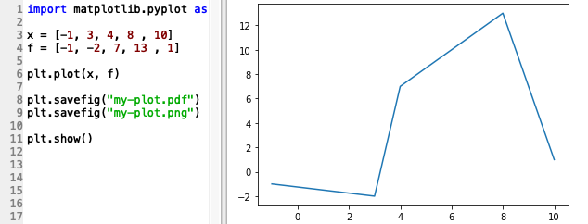

Saving a Plot
Save figure in the current directory
If called before saving, saved figure will be blank

Slide 3
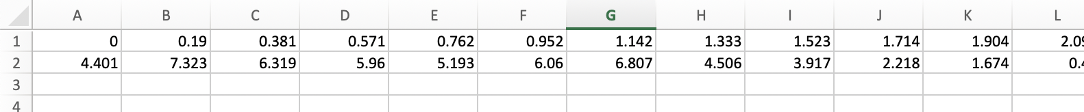
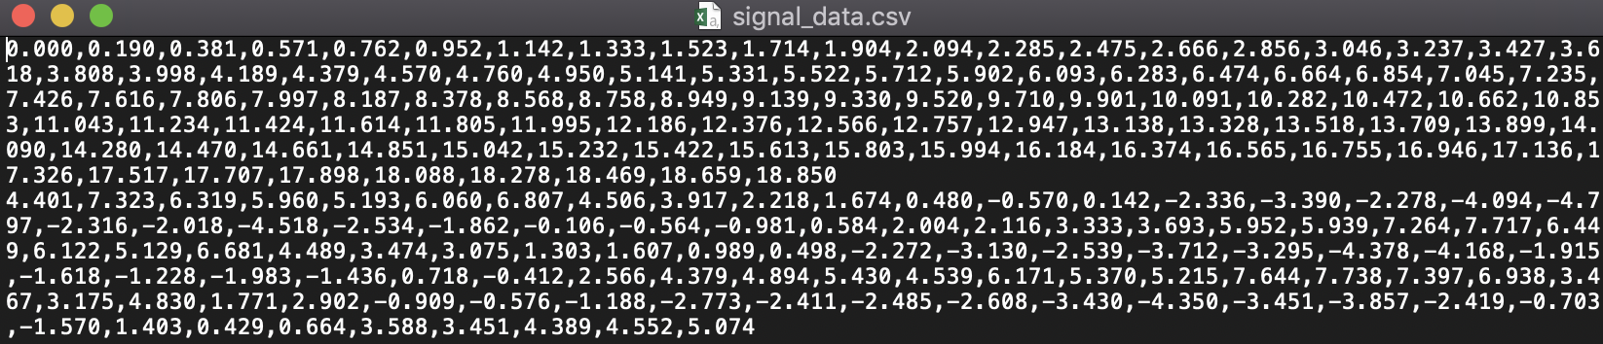
Importing data

Slide 4
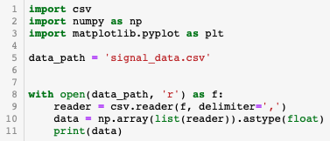
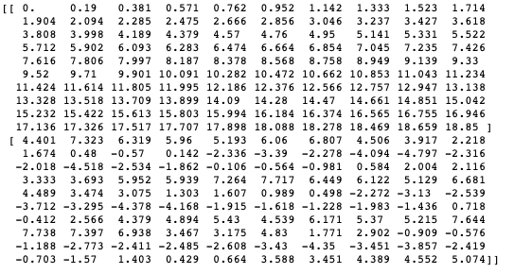
Importing data
File in current directory
Open as read only
Specify delimiter
Convert imported data to numpy array
2 rows,
100 columns

Slide 5
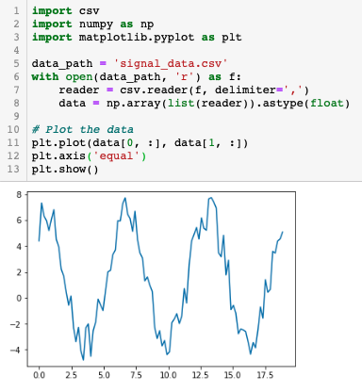
Importing data

Slide 6
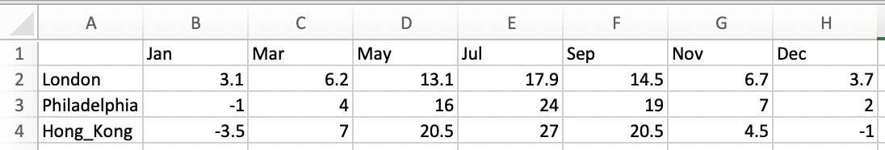

Importing data
temperature_data.csv
Operations on reader must be completed before file closed

Slide 7
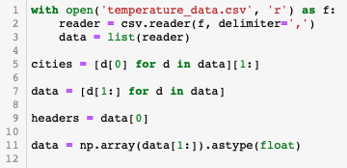

Importing data
First item of each row of data
Remove first item of each list
First list
Data to numpy array
Notes:
Cut and retake. Astype float needed

Slide 8
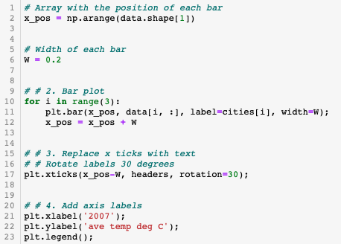
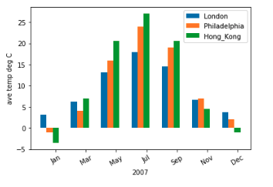
Importing data

Slide 9

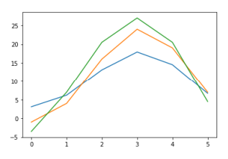
Load CSV with Numpy
Only numerical values can be extracted

Slide 10
Load CSV with Numpy
Headers can be used to address columns of data
Notes:
Remove this example from the end of the video as it doesn’t work

